Slide 1
ODR and the Rise of the Fourth Party
Colin Rule
Pepperdine Straus
January 10, 2025

Slide 2
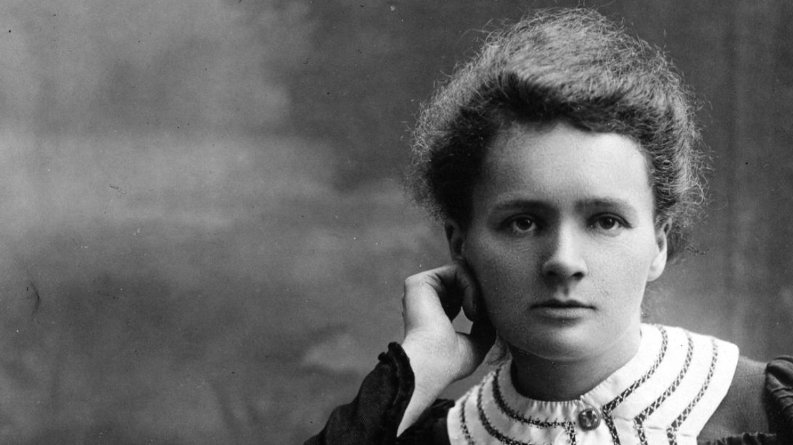
Marie Curie
Notes:
Marie Curie was the first woman to be awarded a Nobel Prize, the first person to get the Nobel prize twice. And the only person to win the Nobel Prize in two different scientific fields --Physics and Chemistry. Along with her husband Pierre, she discovered the element Radium and did pioneeingr research on radioactivity. The effects of radiation were not well understood then. Exposure to radationimpacted her health and cost her her life.

Slide 3
Notes:
Once radium moved from the lab to production it was available to manufacturers to use in different ways.

Slide 4
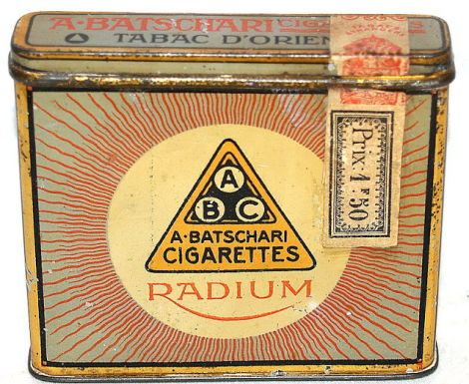
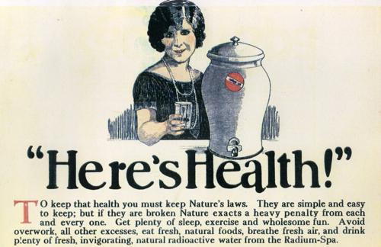
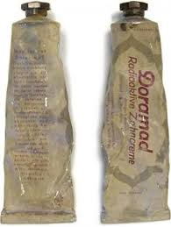
Notes:
And they did. It was used in cosmetics, cigarettes, and toothpaste.Sometimes the name was just slapped on even if the product did not have radium.

Slide 5
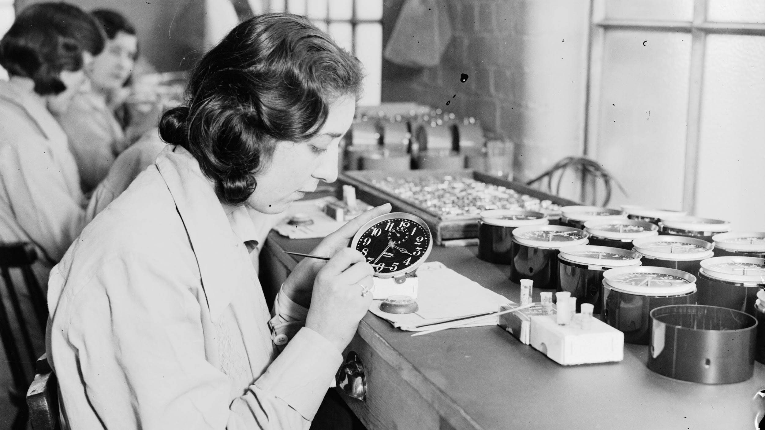
Source: Wikipedia - “Radium Girls”
Notes:
It was used on clocks and watches to make the numerals and hands glow in the dark. The workers who hand painted the dials were told it was safe and they were given no protection. Their health suffered and many died at an early age. It took time and work to understand the effects of radioactivity, to learn how to protect against it. Today radium is used in limited industrial and medical use.

Slide 6
Notes:
New advancements in science and technology follow the trajectory of discovery, excitement, hype. Then slowly we understand its impact and how and where to use it.

Slide 7
A I
Notes:
AI may be on the same trajectory. AI is an tmbrella term that’s used for several technologies including machine learning, natural language processing (NLP), facial recognition. These technologies are evolving at a rapid rate and we are just beginning to understand their potential and dangers. And we are beginning to ask the difficult question -- which tasks that are currently done by humans CAN or SHOULD be done by machines?

Slide 8
Notes:
WHAT ARE WE TALKING ABOUT?
HOW DOES IT WORK?
Simple description for purposes here
‘Learn’ is in quotations because it is not learning they way humans do
‘predict’, and not ‘recommend’ to remind us this is usually statistics and correlation,
NOT reasoning or causation
TALKING ABOUT AI TOOLS THAT MAKE DECISIONS AFFECTING PEOPLE’S LIVES,
NOT TOOLS CONTROLLING MACHINES, IoT, ETC.

Slide 9
Notes:
WHAT ARE WE TALKING ABOUT?
HOW DOES IT WORK?
Simple description for purposes here
‘Learn’ is in quotations because it is not learning they way humans do
‘predict’, and not ‘recommend’ to remind us this is usually statistics and correlation,
NOT reasoning or causation
TALKING ABOUT AI TOOLS THAT MAKE DECISIONS AFFECTING PEOPLE’S LIVES,
NOT TOOLS CONTROLLING MACHINES, IoT, ETC.

Slide 10
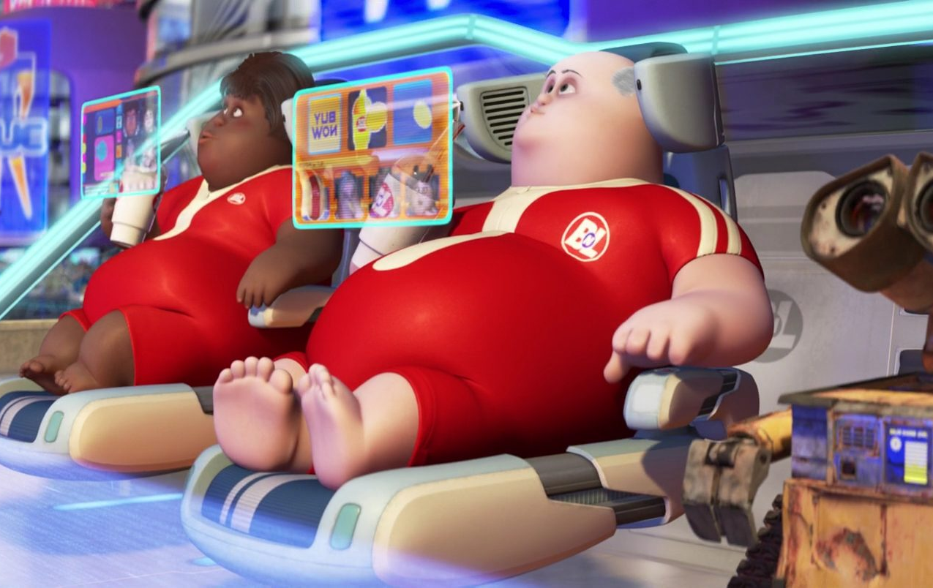
Notes:
WHAT ARE WE TALKING ABOUT?
HOW DOES IT WORK?
Simple description for purposes here
‘Learn’ is in quotations because it is not learning they way humans do
‘predict’, and not ‘recommend’ to remind us this is usually statistics and correlation,
NOT reasoning or causation
TALKING ABOUT AI TOOLS THAT MAKE DECISIONS AFFECTING PEOPLE’S LIVES,
NOT TOOLS CONTROLLING MACHINES, IoT, ETC.

Slide 11
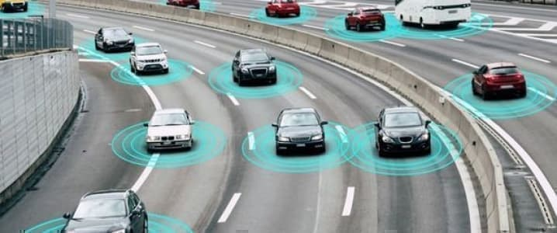
Notes:
WHAT ARE WE TALKING ABOUT?
HOW DOES IT WORK?
Simple description for purposes here
‘Learn’ is in quotations because it is not learning they way humans do
‘predict’, and not ‘recommend’ to remind us this is usually statistics and correlation,
NOT reasoning or causation
TALKING ABOUT AI TOOLS THAT MAKE DECISIONS AFFECTING PEOPLE’S LIVES,
NOT TOOLS CONTROLLING MACHINES, IoT, ETC.

Slide 12
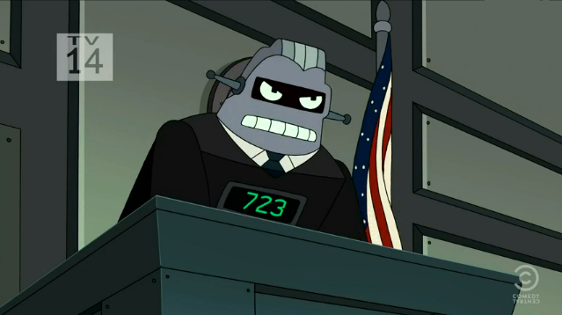
Notes:
WHAT ARE WE TALKING ABOUT?
HOW DOES IT WORK?
Simple description for purposes here
‘Learn’ is in quotations because it is not learning they way humans do
‘predict’, and not ‘recommend’ to remind us this is usually statistics and correlation,
NOT reasoning or causation
TALKING ABOUT AI TOOLS THAT MAKE DECISIONS AFFECTING PEOPLE’S LIVES,
NOT TOOLS CONTROLLING MACHINES, IoT, ETC.

Slide 13
Notes:
WHAT ARE WE TALKING ABOUT?
HOW DOES IT WORK?
Simple description for purposes here
‘Learn’ is in quotations because it is not learning they way humans do
‘predict’, and not ‘recommend’ to remind us this is usually statistics and correlation,
NOT reasoning or causation
TALKING ABOUT AI TOOLS THAT MAKE DECISIONS AFFECTING PEOPLE’S LIVES,
NOT TOOLS CONTROLLING MACHINES, IoT, ETC.

Slide 14
How does AI work?
AI methods ‘learn’ by observation, essentially pattern recognition, and generate a decision-making tool that predicts an outcome based on input values
Notes:
WHAT ARE WE TALKING ABOUT?
HOW DOES IT WORK?
Simple description for purposes here
‘Learn’ is in quotations because it is not learning they way humans do
‘predict’, and not ‘recommend’ to remind us this is usually statistics and correlation,
NOT reasoning or causation
TALKING ABOUT AI TOOLS THAT MAKE DECISIONS AFFECTING PEOPLE’S LIVES,
NOT TOOLS CONTROLLING MACHINES, IoT, ETC.

Slide 15
Sample Data
Correlation
Computer
Expected Result
Learning
Prediction
New Data
Result
Computer
Model

Slide 16
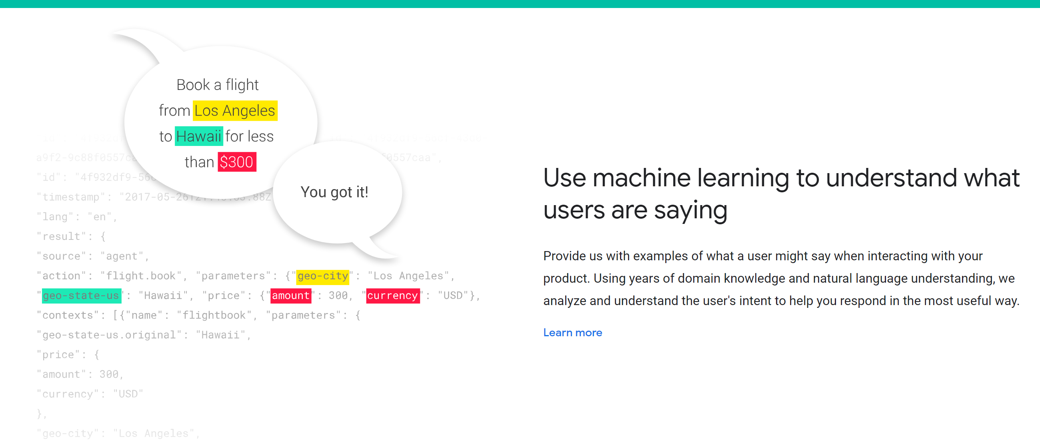
Generative AI
A large neural network machine learning algorithm that predicts the next word in a series using the rules it has gleaned from analyzing billions of data segments drawn from the internet
Large Learning Models (LLMs) do not require training on structured data sets – they take enormous amounts of unstructured data and find patterns

Slide 17
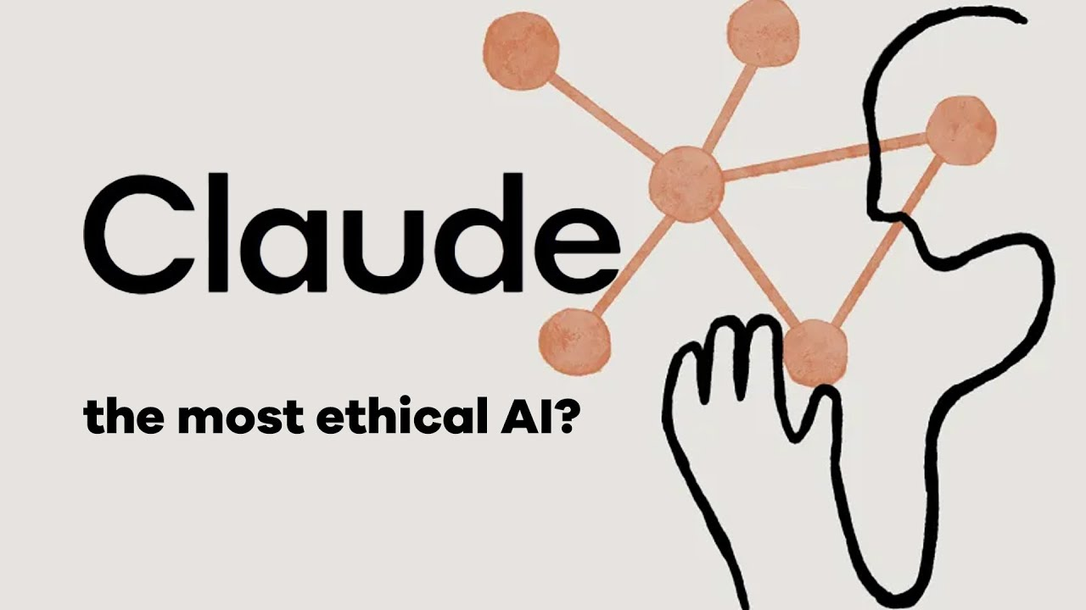

Slide 18
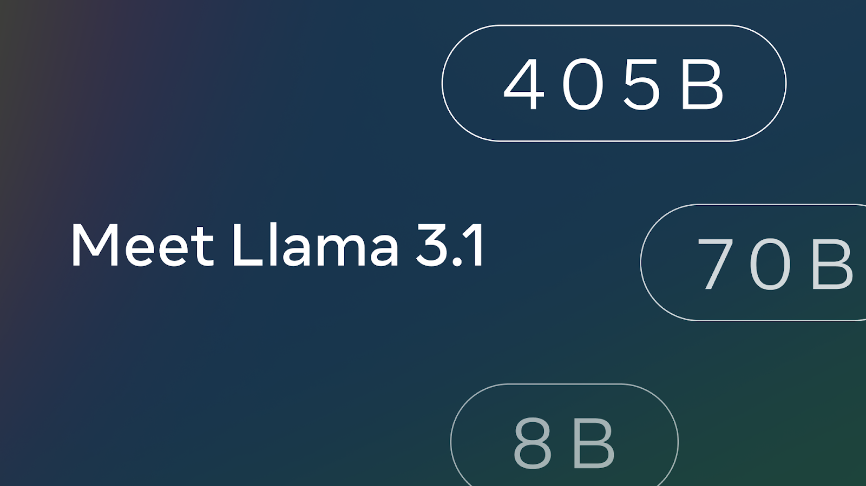

Slide 19
What is RAG?
Retrieval augmented generation, or RAG, is an architectural approach that can improve the efficacy of large language model (LLM) applications by leveraging custom data. This is done by retrieving data/documents relevant to a question or task and providing them as context for the LLM.

Slide 21
“There’s nothing artiﬁcial about AI. It’s inspired by people,
it’s created by people, and—most importantly— it impacts people. ”
— Fei-Fei Li
Source: https://www.wired.com/story/fei-fei-li-artiﬁcial-intelligence-humanity/
Notes:
SOURCE OF QUOTE: “Artificial Intelligence: Do stupid things faster with more energy!”, at: https://towardsdatascience.com/artificial-intelligence-do-stupid-things-faster-with-more-energy-379aa6bac220

Slide 22
“It’s not the genie that’s dangerous,
it’s the unskilled wisher.” - Cassie Kozyrkov, Chief Decision Scientist, Google

Slide 24
“An algorithm is an opinion embedded in mathematics” Cathy O’Neil, author of Weapons of Math Destruction
“Algorithms are neither good nor bad,
but they are certainly not neutral” Kranzberg’s First Law of Technology
Technology and Culture, Vol. 27, No. 3 (July 1986), pp. 544-560
Notes:
WHAT TO REMEMBER ABOUT AI TOOLS
To help you understand what they do, and what they don’t do
An algorithm is an “opinion embedded in mathematics” -- Cathy O’Neil, author of Weapons of Math Destruction
CORRELATION, NOT CAUSATION
Where is the knowledge we have lost in information? -- T.S. Eliot
Not coming up with theories of laws of nature, just patterns
Cassie Kozyrkov, head of Decision Intelligence for Google:
You can use AI to find “patterns in data instead of having to meditate your way to a solution. Do you realize how powerful this is? It means that even if you can’t come up with instructions, you might be able to automate your task anyway.”
“It’s a set of tools for writing software a different way, letting you program with examples (data) instead of explicit instructions.”

Slide 25
Notes:
WHAT ARE WE TALKING ABOUT?
HOW DOES IT WORK?
Simple description for purposes here
‘Learn’ is in quotations because it is not learning they way humans do
‘predict’, and not ‘recommend’ to remind us this is usually statistics and correlation,
NOT reasoning or causation
TALKING ABOUT AI TOOLS THAT MAKE DECISIONS AFFECTING PEOPLE’S LIVES,
NOT TOOLS CONTROLLING MACHINES, IoT, ETC.

Slide 26
Meet the Fourth Party
A partner in resolutions
Lightens administrative loads
Saves money
Builds credibility
Becoming more capable all the time
Always in the parties’ pockets
Able to do things humans can’t (or shouldn’t) do

Slide 27
What can the fourth party do today?
Intake / Diagnosis
Processing Payments
Case administration
Notifications
Document management
Calendars / Scheduling
Assisted negotiation

Slide 28
What will the fourth party do tomorrow?
Research
Case evaluation / ZOPA
Coaching
Reframing / BATNA
Enforcement
Document drafting & submission
Automated negotiation

Slide 29
Potential for RAG LLMs and ODR
Document queries for all documents uploaded into a workspace
AI assisted case filing (natural language)
AI assisted document generation (creating draft settlement agreements)
AI assisted panelist search
AI mediator - AI asking questions, reframing, urging toward settlement
AI tone monitoring - communication de-toxifying
AI arbitrator - evaluates submitted information, asks questions, renders decision

Slide 30
Envisioning the OMBOT
Available 24x7
Trained on best practices and ethical guidelines
Designed to be friendly, accessible, and conversational
Totally confidential
Can refer to a human ombuds at any time
Closest I have seen so far:

Slide 31
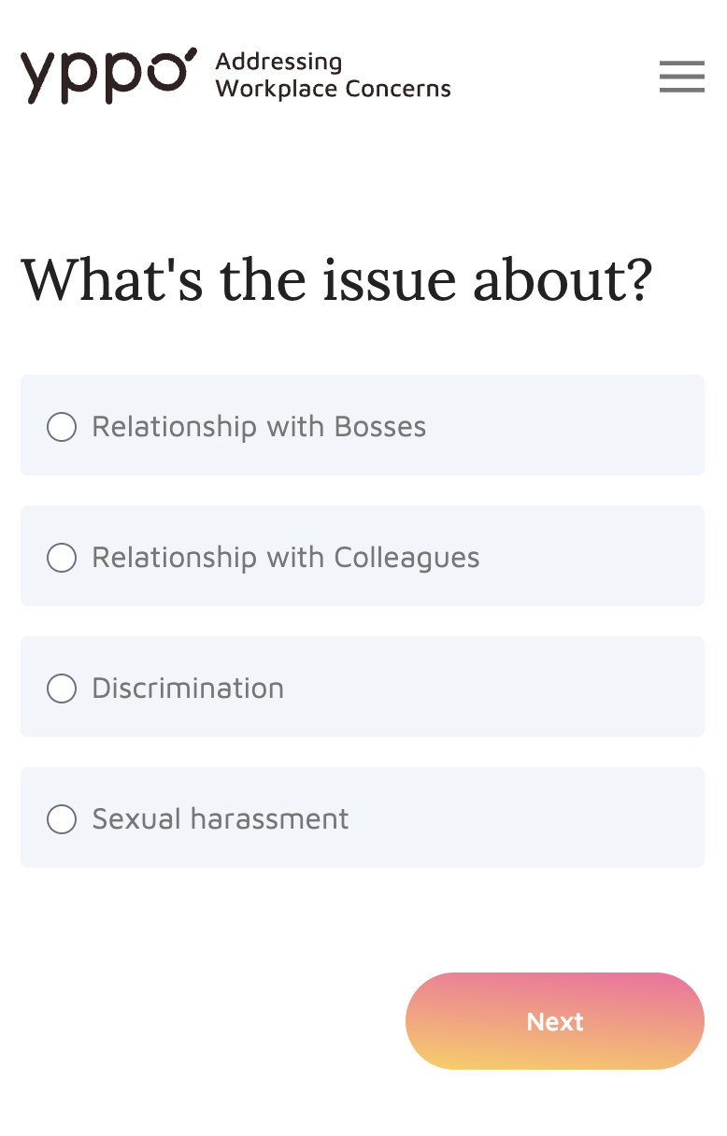
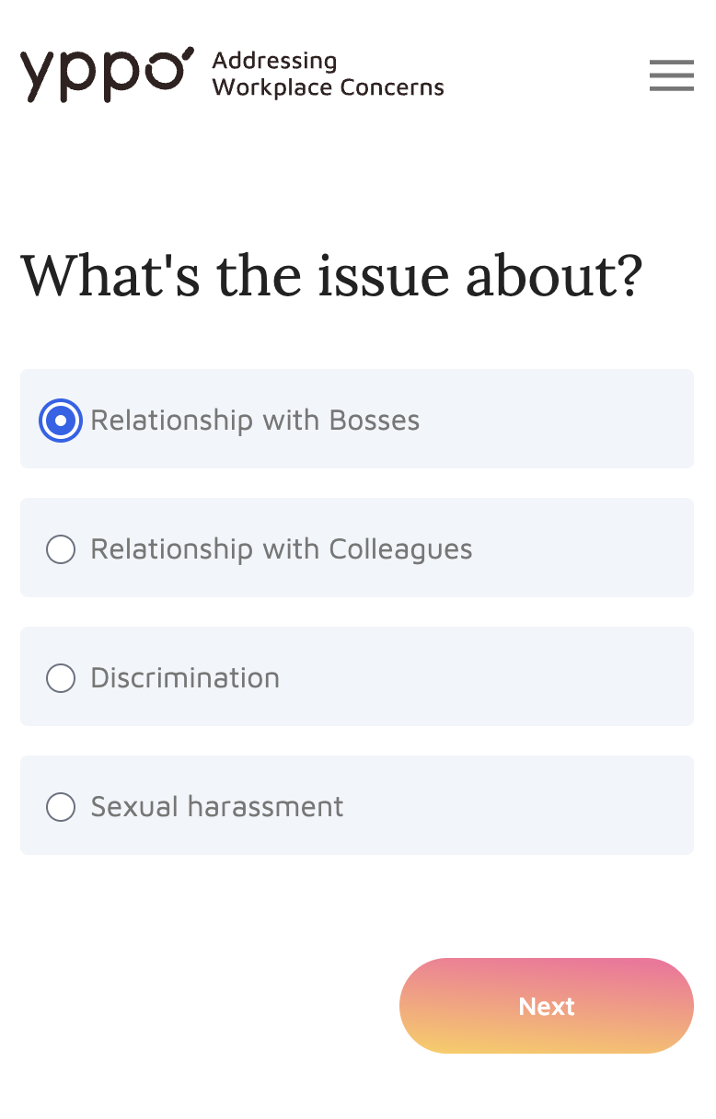

Slide 32
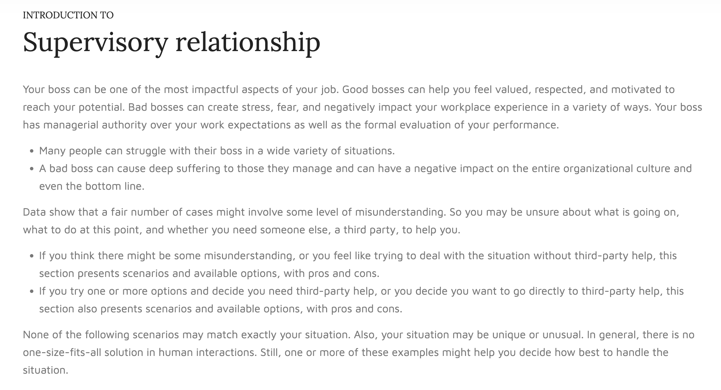

Slide 33
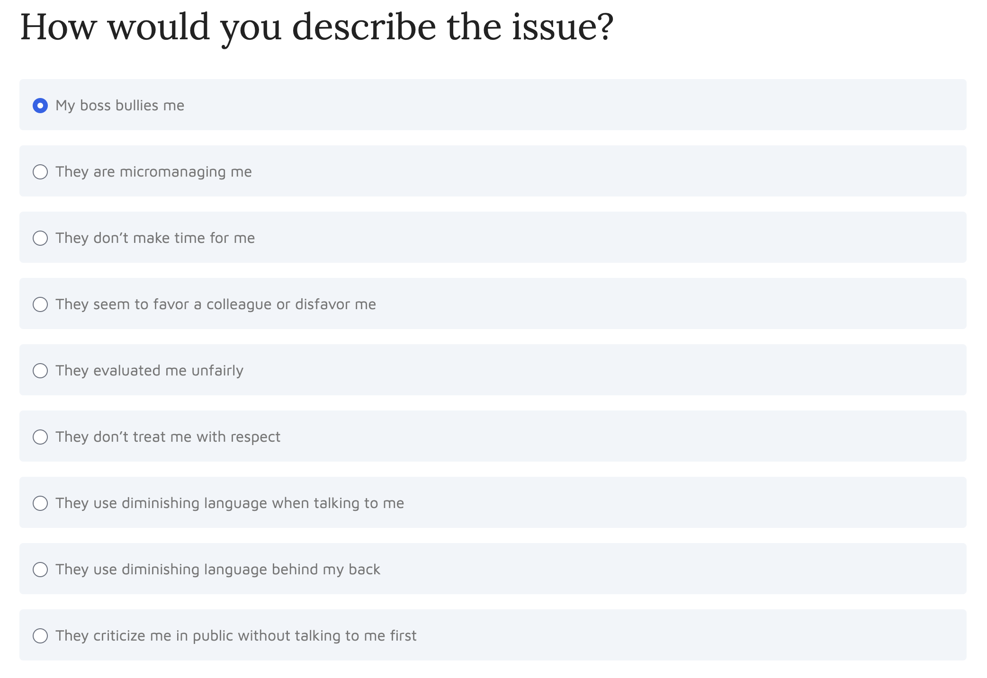

Slide 34
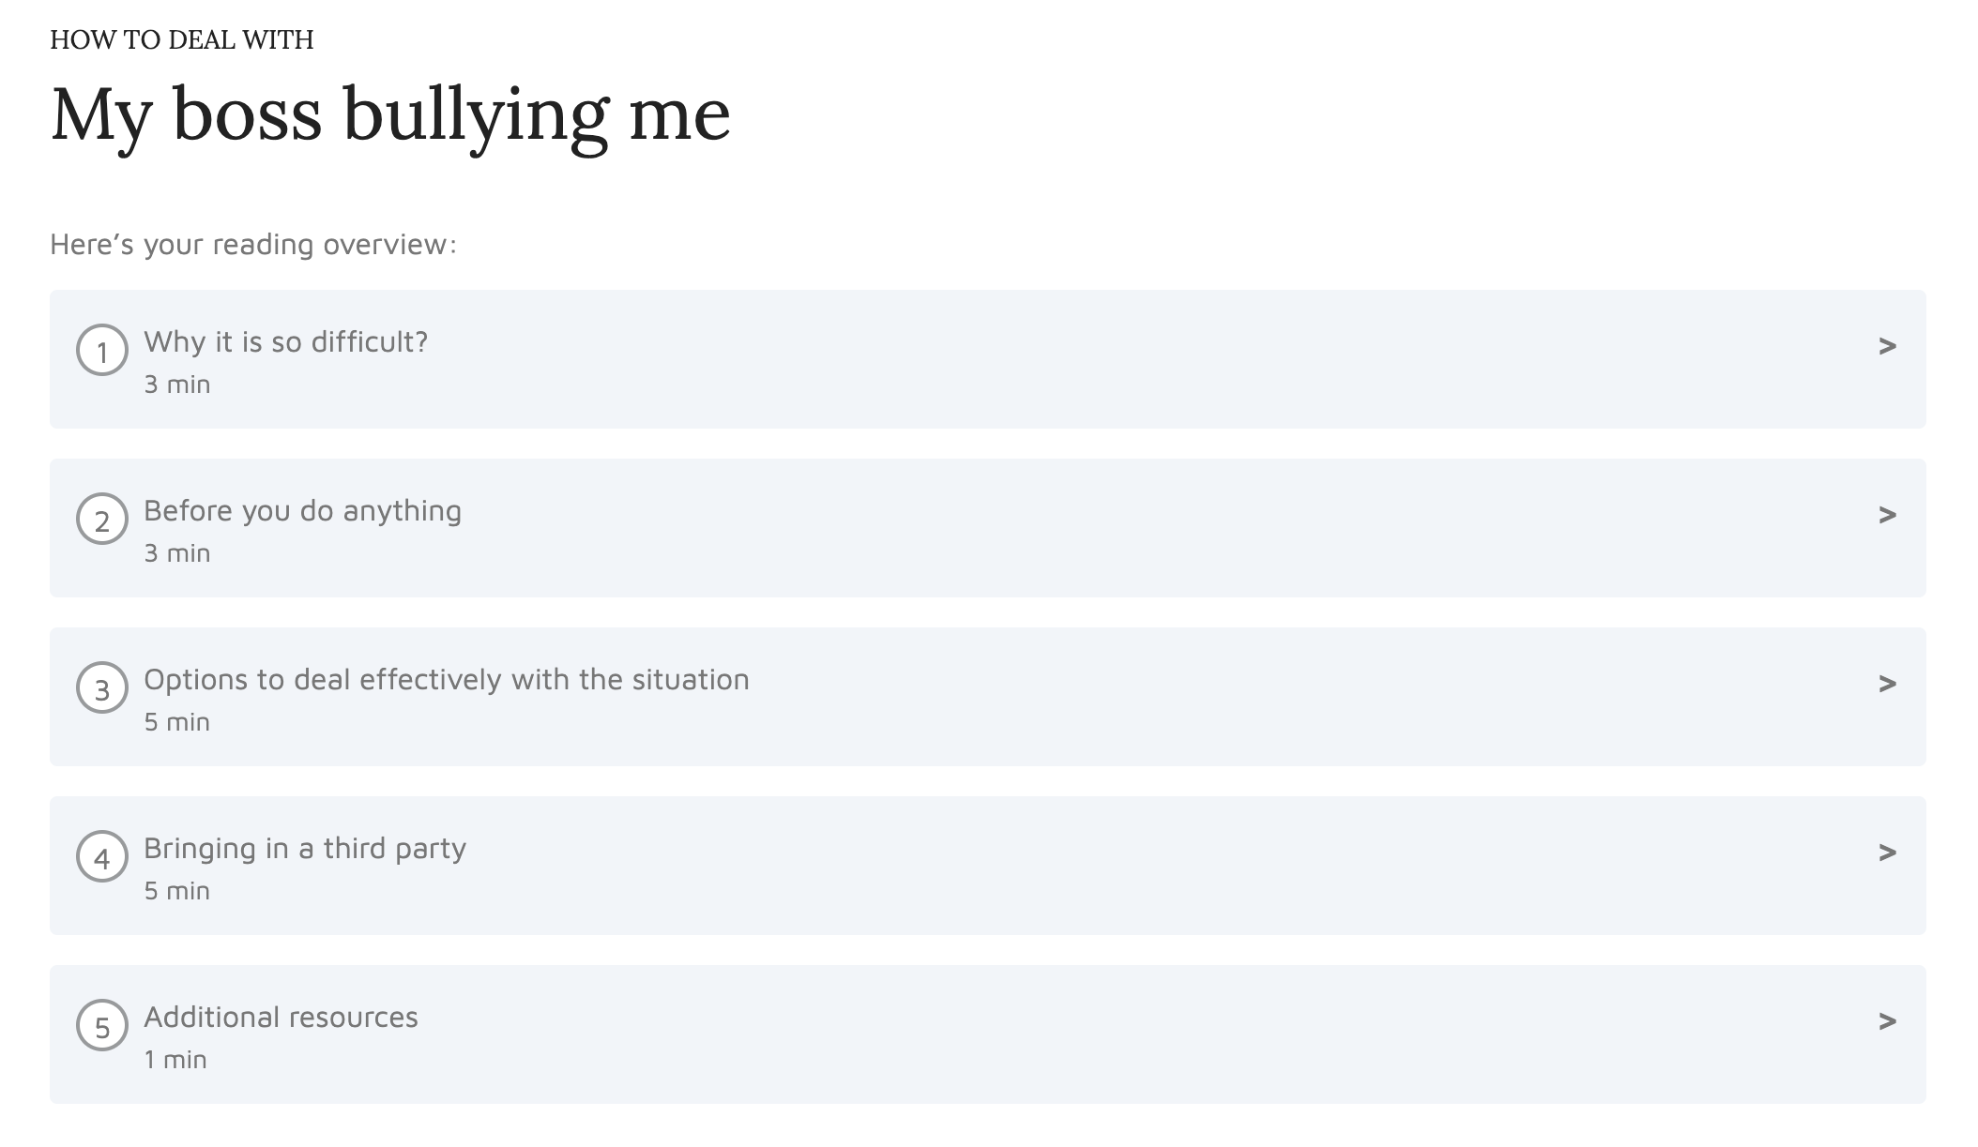

Slide 36
Handling a Harassment case
Supervisee might say this …

Slide 37
Benefits
Challenges
Reduce cost of service
Provide faster service
Provide better service
Serve more people
Data & Privacy
Safety
Regulations
Ethics
Our parties will soon use these tools in every area of their lives, and they will expect to use them in their dispute resolution processes as well
Notes:
These new technologies have a great potential but also pose challenges that are more than the technology itself.

Slide 38
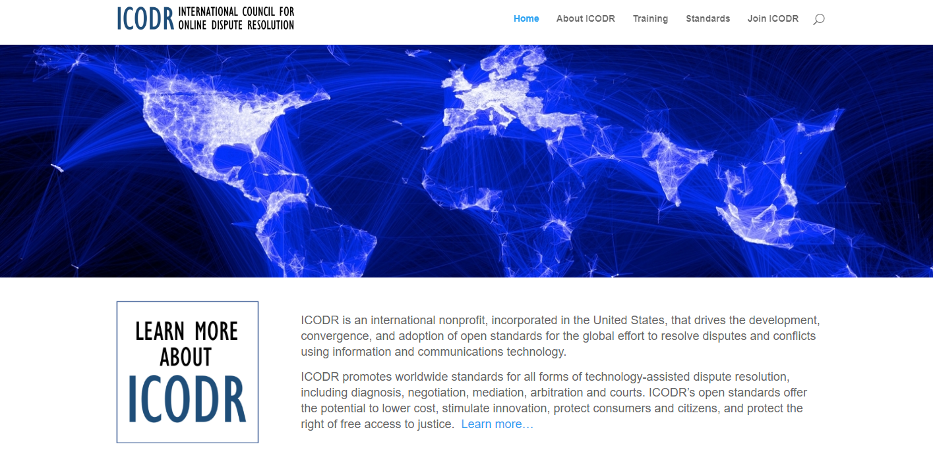
Online Mediator Ethical Standards
Notes:
Court disputes (low value civil cases: e.g. divorce, tenant)
Public disputes (e.g. Property Tax Appeals)
Insurance (e.g. AAA NYNF Process)
Product liability (e.g. Pharmaceuticals)
Consumer (e.g. Ombuds offices, UK CAA)
eCommerce disputes (payments, marketplaces, merchants)

Slide 39
Online Mediator Ethical Standards
Accessible
Accountable
Competent
Confidential
Equal
Fair/Impartial/Neutral
Legal
Secure
Transparent

Slide 40
Ethics for Platform Designers
Potential for Abuse
(it’s easy to build an online kangaroo court)
Certifying and auditing ODR systems
Monitoring for ongoing compliance
Processing complaints
Following the money / perverse incentives
Ethics for the use of algorithmic resolution tools

Slide 41
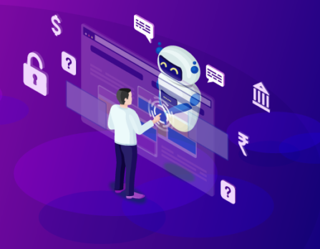
What’s Coming
Artificial Intelligence will expand access to DR
Parties will expect to leverage AI in the resolution process
AIs will progressively improve over time
We need to build our own AIs trained on best practices and ethical guidelines

Slide 43
AI Practice Dilemma #1
You are mediating a dispute between two business partners who are dividing a business and trying to determine how much one partner should pay the other to buy them out of their share. They decide to upload all of the company financials to an AI and ask for the AI’s estimation of the appropriate valuation of the business. One partner uploads the financial data and the AI comes up with an estimate, and the partners agree to use that number. But in later reviewing the data the partner uploaded, you suspect that he may have adjusted a key number in the spreadsheet to influence the AI’s calculations. What do you do?

Slide 44
AI Practice Dilemma #2
As a mediator, you use AI to generate a possible solutions to a dispute between two parties in different countries. After some discussion and consideration of different draft agreements generated by the AI, the parties find a solution and sign. Two months later, a lawyer for one of the parties (who did not represent them at the time of the mediation) contacts you and informs you that the legislature in the home geography for their client does not recognize the enforceability of AI generated agreements, and the lawyer is advising their client that the mediation agreement is invalid. What would you do?

Slide 45
AI Practice Dilemma #3
A mediator uses an AI to consult on a case, and after analyzing the information submitted the AI suggests one of the documents shared by the complainant is inauthentic. There is no indication visible to the mediator that the document is illegitimate, but the AI is steadfast in its judgement (and it won’t explain its reasoning). How would you handle this situation?

Slide 46
AI Practice Dilemma #4
A mediator submits case facts to a publicly available AI that does not protect the confidentiality of submissions. The mediator did not realize that the AI integrates information from submissions into its public data, and later when the mediator asks specific questions about the individual case the AI answers them. What would you do?

Slide 47
AI Practice Dilemma #5
A mediator uses AI to generate a settlement agreement and shares it with the parties, and the parties see that one of the points of agreement appears to be hallucinated, so they ask if the mediator used an AI tool to generate the document. The mediator did not inform the parties in advance that they would use AI tools in the mediation. What would you do?

Slide 48
AI Practice Dilemma #6
You are mediating a workplace dispute in a text-based discussion over unpaid wages, and the posts from the business seem oddly generic to you. The former employee keeps asking specific questions and the business manager keeps responding in generalities. You suspect the manager may be generating their responses in an AI program, or an AI program is participating in the process instead of the live manager. What do you do?

Slide 49
AI Practice Dilemma #7
As a mediator, and with the agreement of your parties, you use an AI tool to generate some solution possibilities, and the parties decide to use one of the solutions as the basis for their own agreement. You build an agreement around the solution and the parties sign it. A few months later a news report reveals that the AI tool you utilized was trained on some fake data that could potentially bias the solutions it recommends. One of the parties contacts you expressing concerns that maybe the fake data could have affected the solution it proposed in her case. How would you respond?

