Slide 1
Online
Dispute
Resolution
Expanding Access to Justice

Slide 2
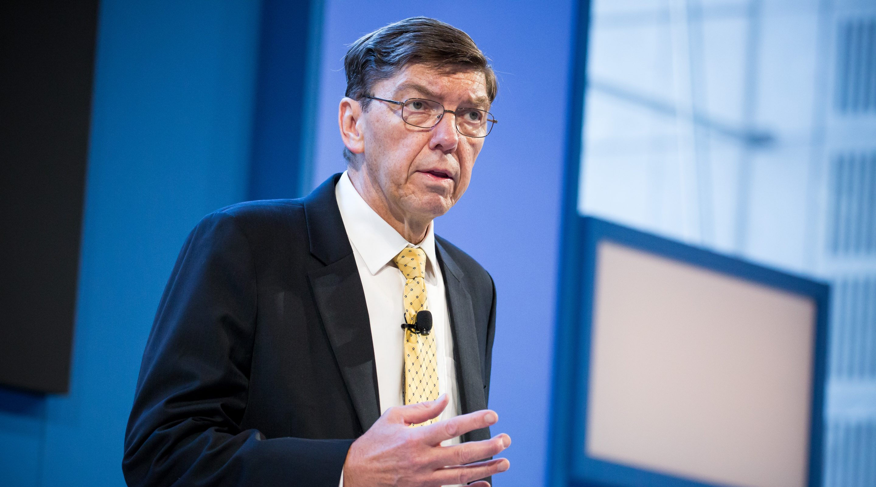
“Empowering innovations transform something that is complicated and expensive into something that is so much more simple and affordable that a much larger population can enjoy it.” – Clayton Christensen
Notes:
Court disputes (low value civil cases: e.g. divorce, tenant)
Public disputes (e.g. Property Tax Appeals)
Insurance (e.g. AAA NYNF Process)
Product liability (e.g. Pharmaceuticals)
Consumer (e.g. Ombuds offices, UK CAA)
eCommerce disputes (payments, marketplaces, merchants)

Slide 3
The legal system doesn’t work over the internet
Online cases are low value and cross-border
Enforcement is too complex
Users demand fast, one-click resolutions
ODR works the way the internet works
No need to resolve issues of jurisdiction
Redress is built directly into contracts
Can be automated through software

Slide 4
ODR’s roots
ODR was originally developed to meet the needs of eCommerce companies like eBay and PayPal.

Slide 5
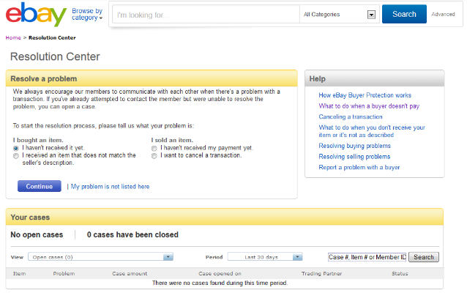
Scaling ODR
eBay ODR resolutions
60+ million disputes per year
50% resolved amicably
90% resolved in software, with no human intervention
Extrajudicial process, with 100% private enforcement of outcomes

Slide 6
Applying ODR outside of eCommerce
Court disputes
Insurance
Product liability
Public disputes
Consumer disputes
E-commerce
Notes:
Court disputes (low value civil cases: e.g. divorce, tenant)
Public disputes (e.g. Property Tax Appeals)
Insurance (e.g. AAA NYNF Process)
Product liability (e.g. Pharmaceuticals)
Consumer (e.g. Ombuds offices, UK CAA)
eCommerce disputes (payments, marketplaces, merchants)

Slide 7
ODR is resolving millions of disputes around the world
United Kingdom: Her Majesty’s Online Court
British Columbia Civil Resolution Tribunal
EU ODR Regulation for Businesses
UNCITRAL Cross-Border Resolutions
ODR programs are growing around the world at an increasing rate
Notes:
UNCITRAL ODR Working Group
· Held 5 years of Working Group Meetings in Vienna and NYC
· 66 member countries participated
· Issued recommendations that ODR be provided to citizens for cross-border cases
· Recommendations adopted by the UN General Assembly
UK Civil Justice Commission – Her Majesty’s Online Court
· Creating a new online court for low dollar value civil cases
· MOJ created a £750m fund to build this new online court
· Does not require filer to have a lawyer
BC Civil Resolution Tribunal (CRT)
· Uses ODR to resolve low dollar value civil cases (<$25k CAD)
· Focused on condo (strata) cases and small claims
· Contemplating making the CRT mandatory in civil cases

Slide 8
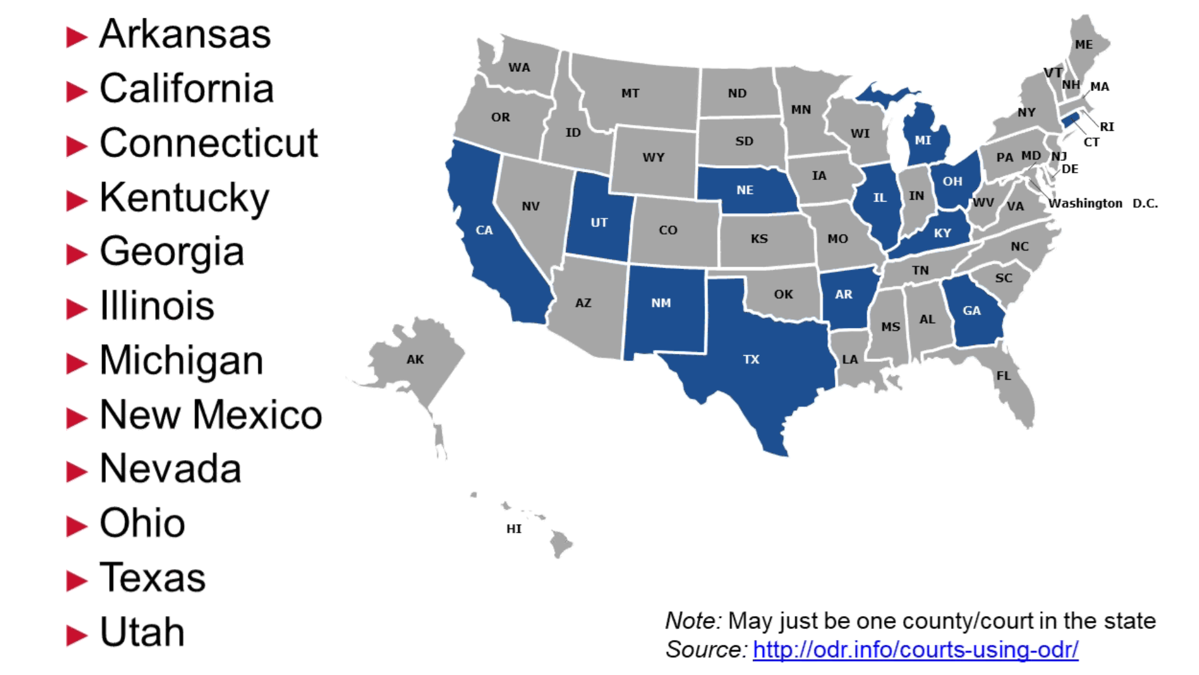
Where are courts using ODR located?
Notes:
We should build this out starting with
Ohio Ct. of Claims
Clark Co
Santa Clara
Fulton
Travis JP
Williamson
LA

Slide 9
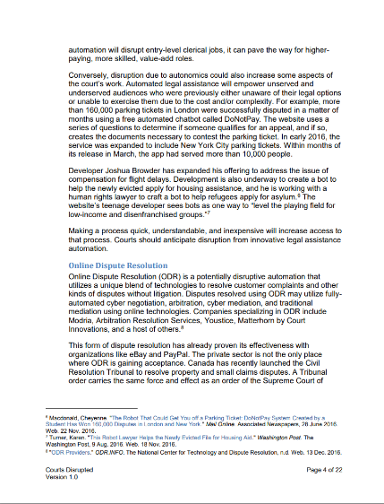
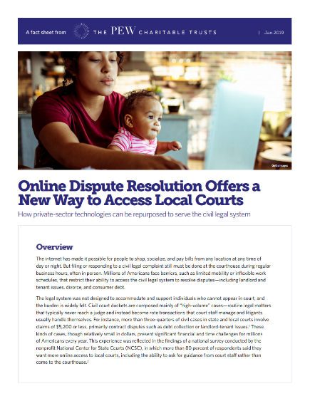
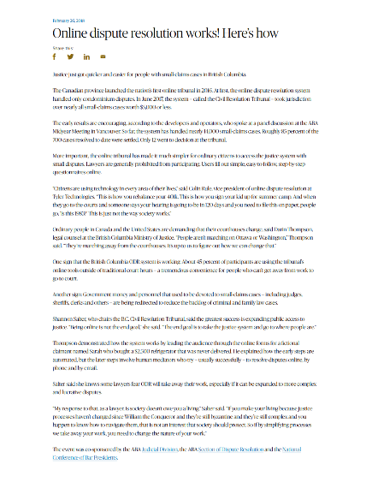
ODR is a powerful tool that can assist jurisdictions in advancing the cause of justice and rule of law
ODR has the potential to improve customer service, boost efficiency, and reduce costs
Court-annexed ODR … would help relieve the overburdened court system and facilitate judicial efficiency
Notes:
Organizations such as:
- Joint Technology Committee
- Pew Charitable Trust
-American Bar Association
Have weighed in on the justice reform initiatives and have come back with overwhelming positive feedback on the expected impact of ODR to the justice system.
Now let me show you how this can fit into your business processes.

Slide 10
ODR process
Diagnosis
Negotiation
Mediation
Evaluation

Slide 11
ODR stages

Slide 12
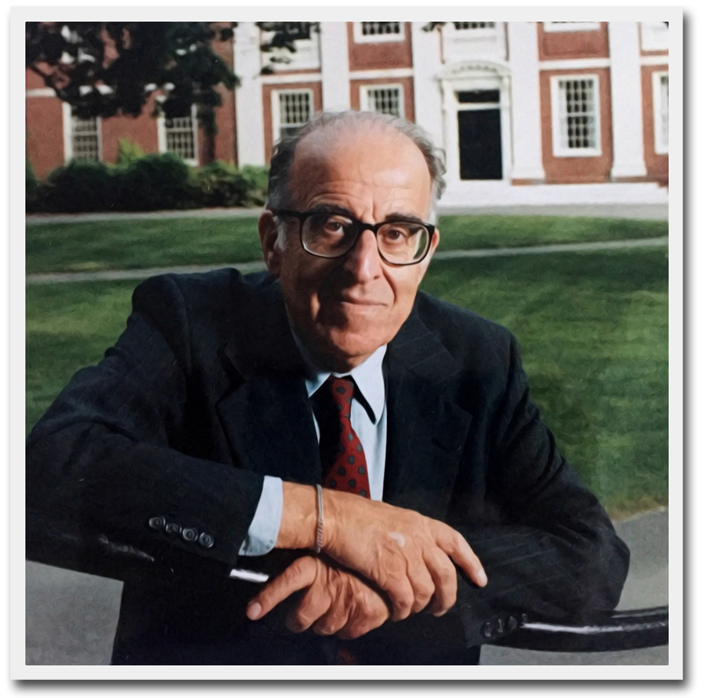
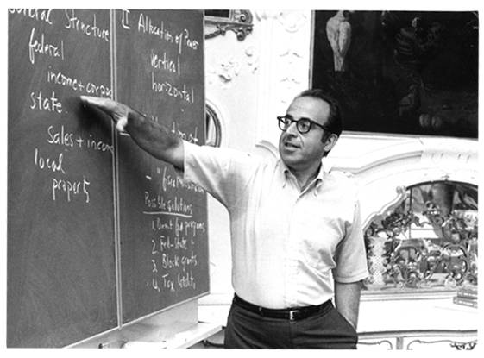
Frank Sander and the Multidoor Courthouse

Slide 13
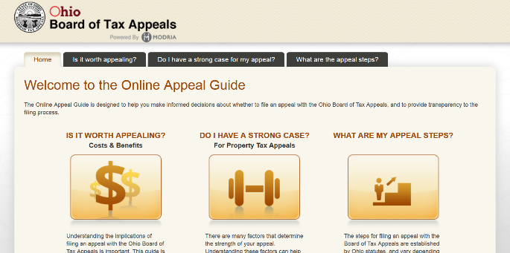
Diagnosis
Set expectations around timing and process
Compile the case file through online intake, applying relevant data and policies
Deliver an automated resolution if appropriate
An online diagnosis guide for potential filers with the Ohio Board of Tax Appeals

Slide 14
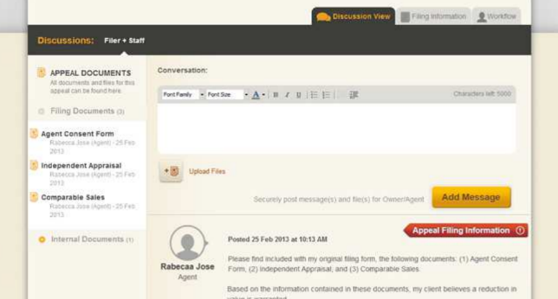
Negotiation
Communication, synchronous or asynchronous
Upload relevant documentation
Make, accept, or reject settlement offers
Draft and accept agreement terms
An online negotiation room for resolving property tax disputes in Nashville, TN

Slide 15
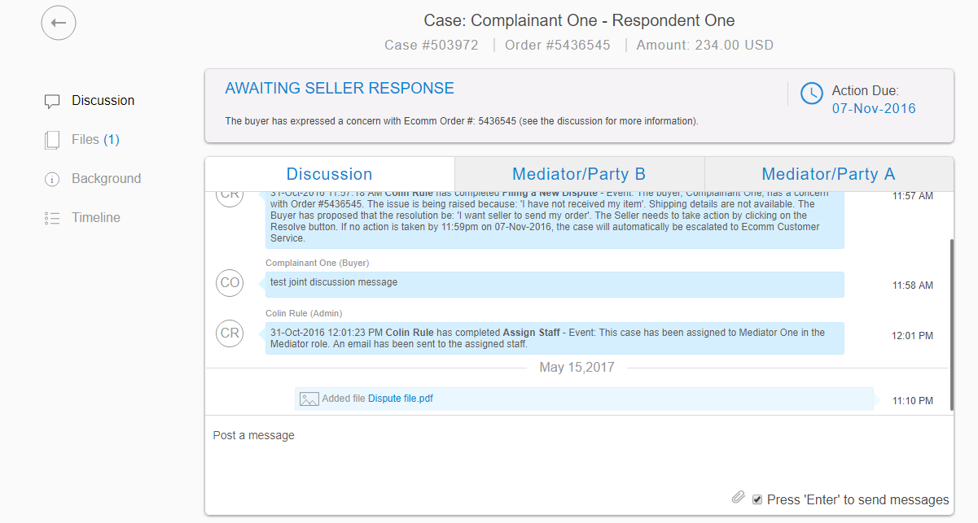
Mediation
Conversations, caucus and joint
Pick mediators by mutual agreement
Consult a library of relevant solutions
Track all issues to closure
An online mediation room for divorcing couples in The Netherlands

Slide 16
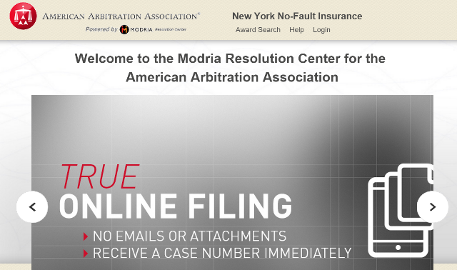
Evaluation
Automatic notifications and case timelines
Automated decision drafting and filing
Integrated billing and account management
An expedited arbitration process for insurance claims in New York

Slide 17
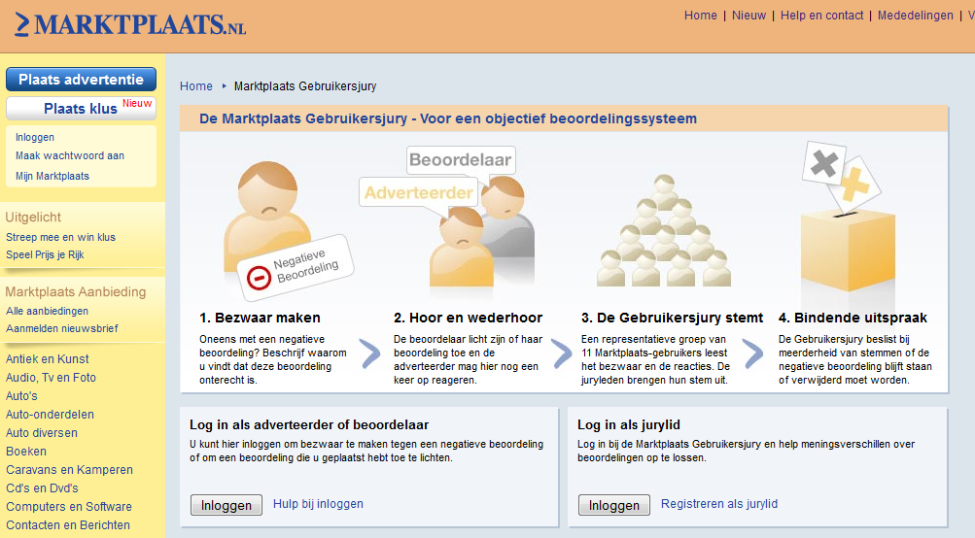
Crowd Sourced Evaluation

Slide 18
Crowd Sourced Justice

Slide 19
Leveraging the Fourth Party
Notes:
WHAT ARE WE TALKING ABOUT?
HOW DOES IT WORK?
Simple description for purposes here
‘Learn’ is in quotations because it is not learning they way humans do
‘predict’, and not ‘recommend’ to remind us this is usually statistics and correlation,
NOT reasoning or causation
TALKING ABOUT AI TOOLS THAT MAKE DECISIONS AFFECTING PEOPLE’S LIVES,
NOT TOOLS CONTROLLING MACHINES, IoT, ETC.

Slide 20
Game Theory + Algorithmic Trust
Decentralized
Always on
Jurisdiction Independent
No laws or lawyers
Automated enforcement

Slide 21
Legal Disruption
Smart Contracts
Blockchain
Machine learning
Algorithmic resolutions
Natural language processing

