Slide 1

Online Dispute Resolution: The State of the Art
Online Dispute Resolution: The State of the Art
Colin Rule Pepperdine Straus
Via zoom

Slide 2
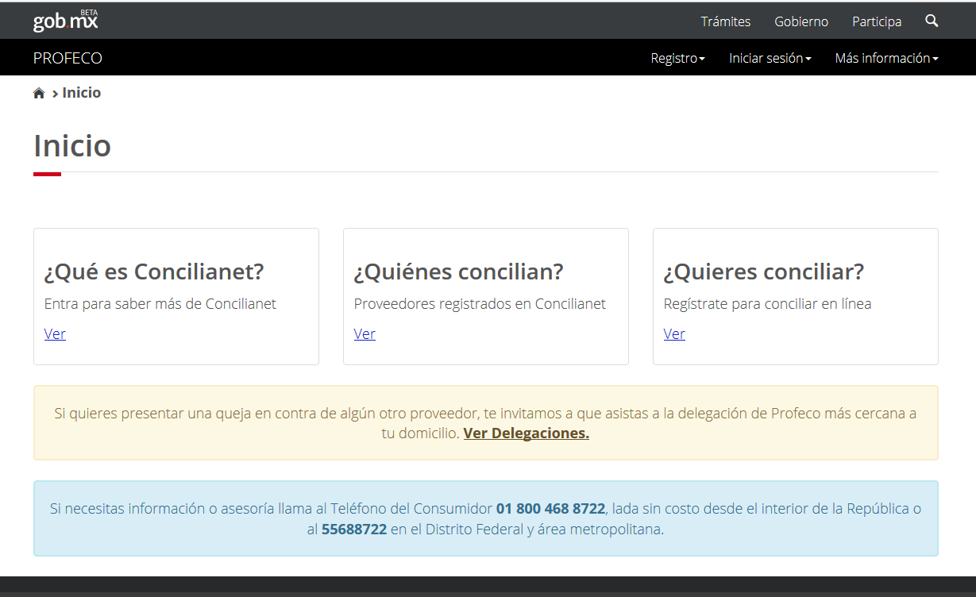

Slide 3
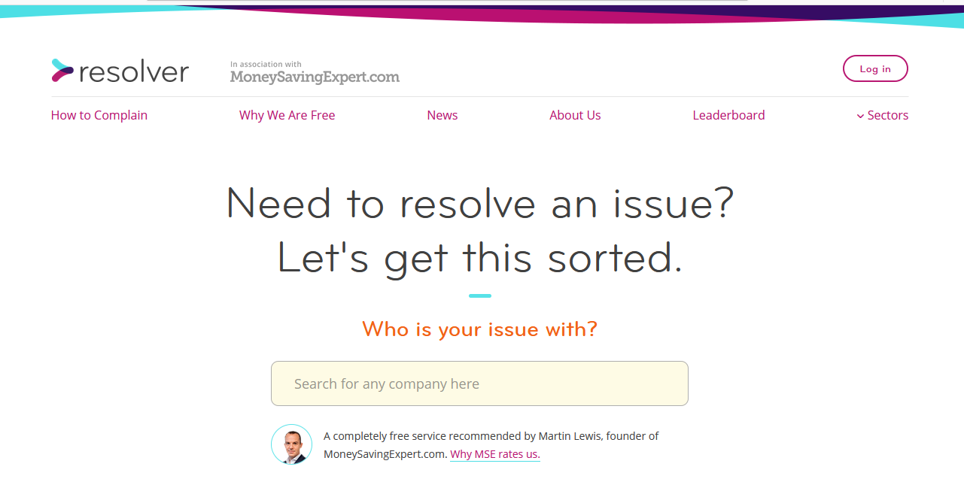

Slide 4
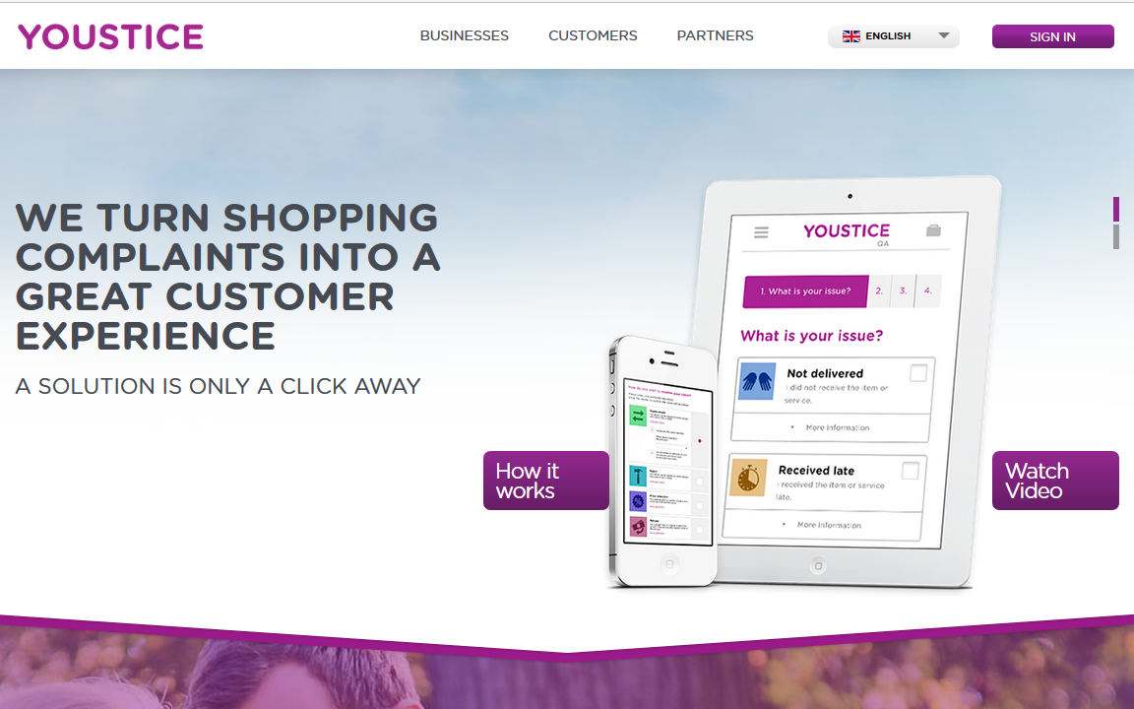

Slide 5
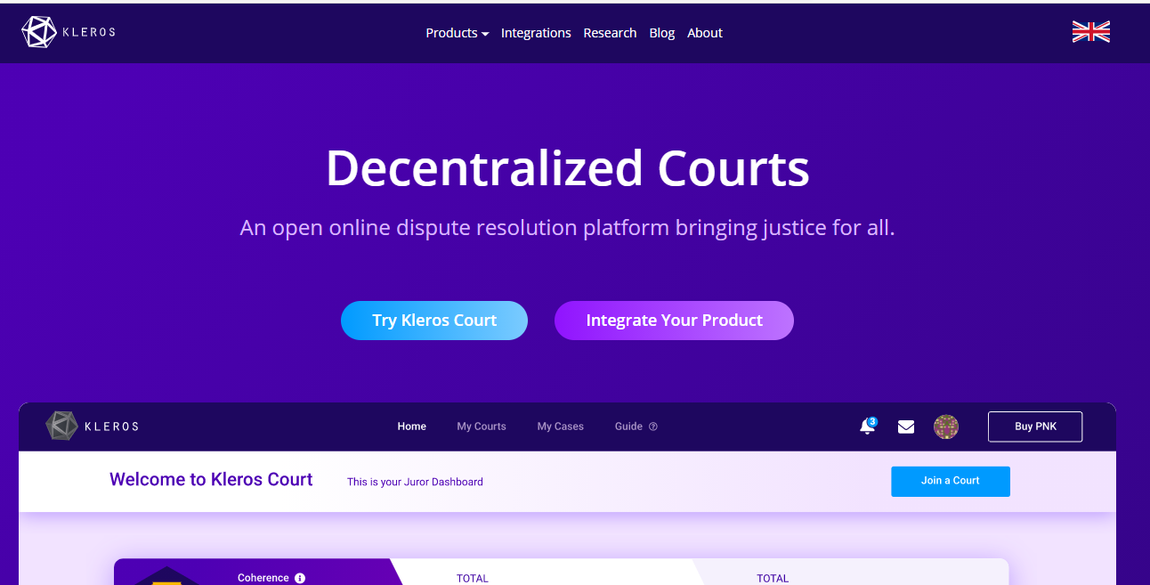

Slide 6

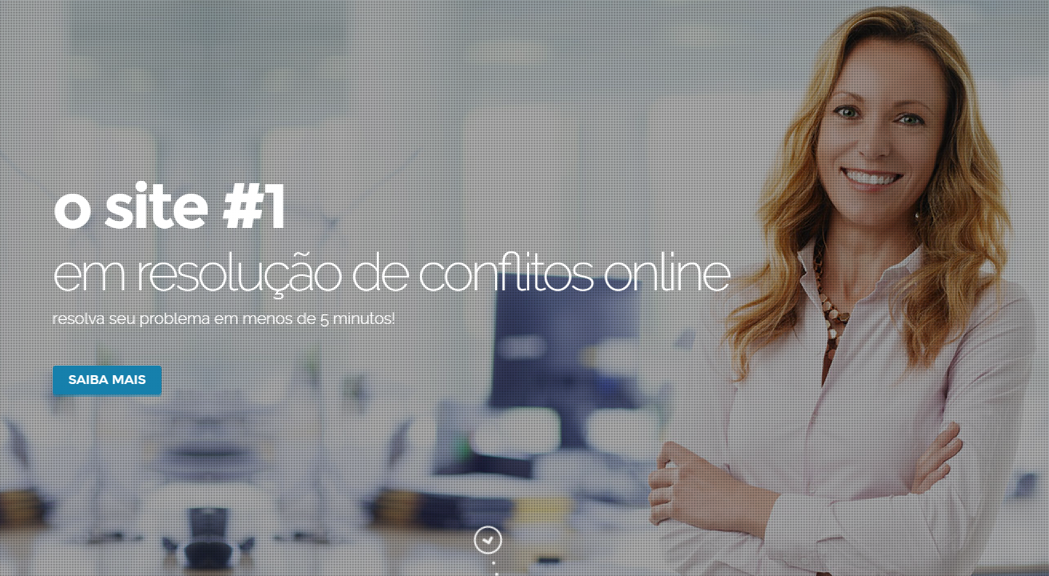

Slide 7
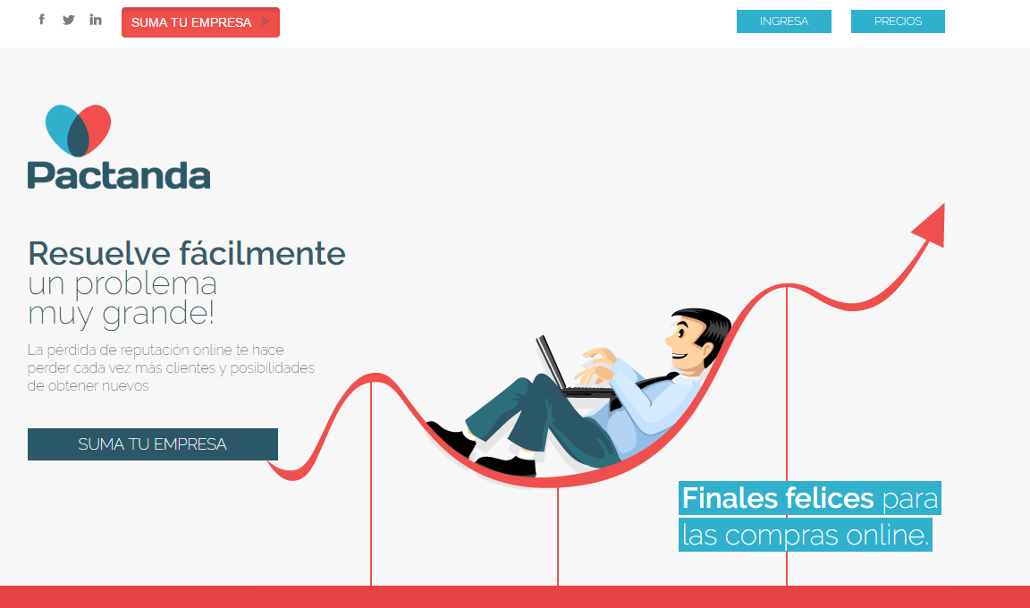

Slide 8
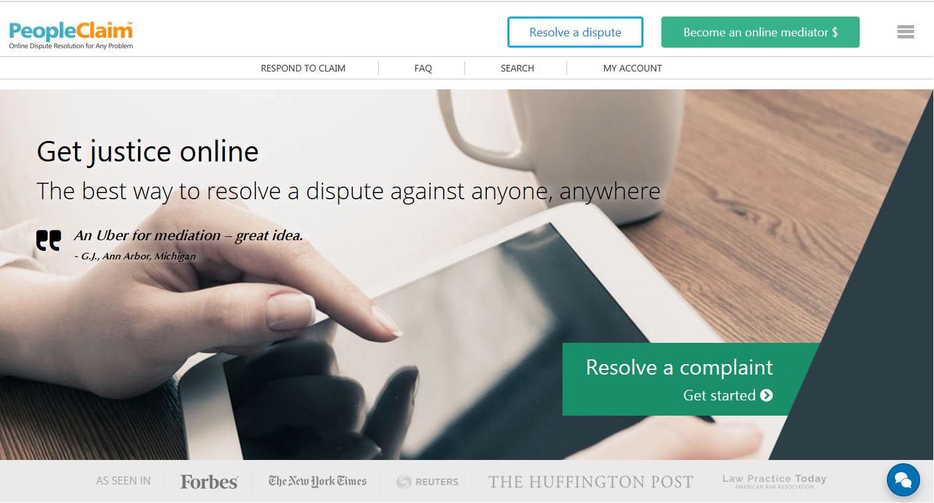

Slide 9
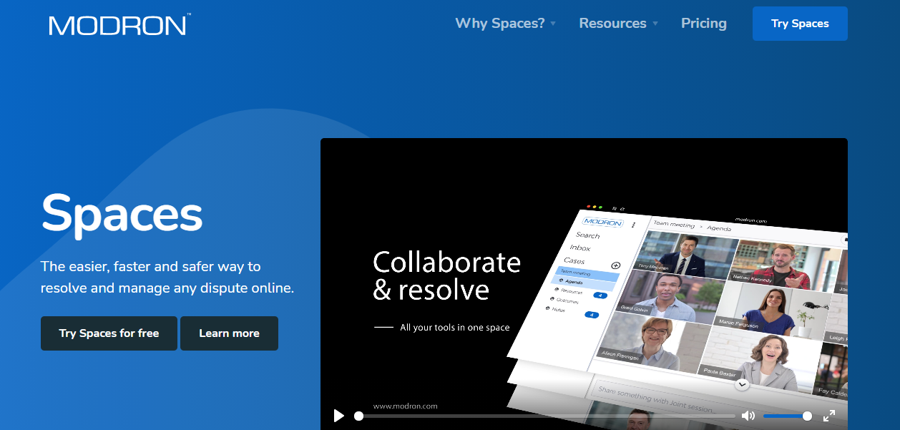

Slide 10
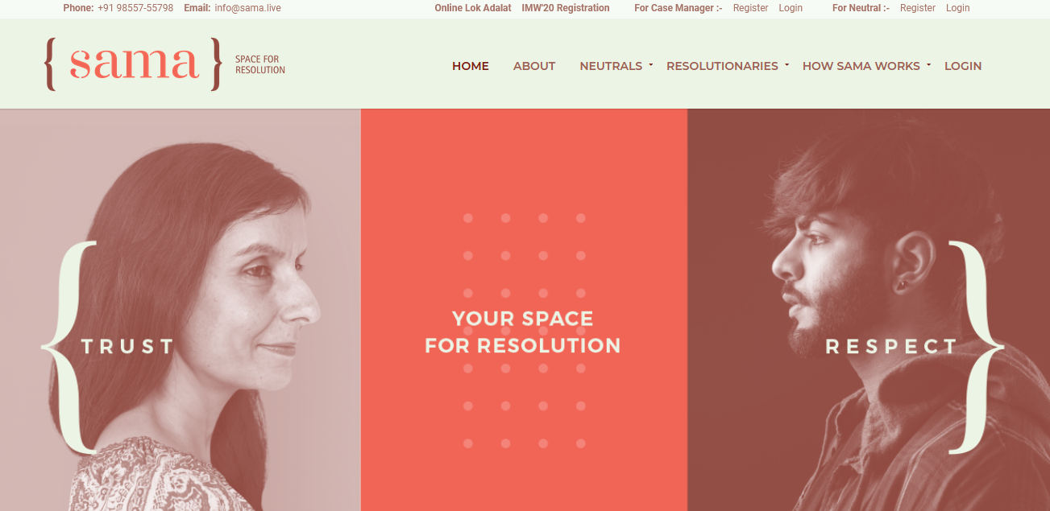

Slide 11
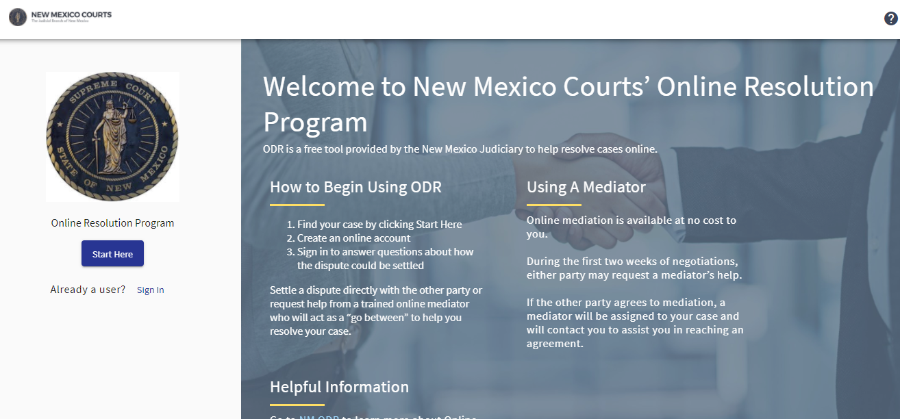

Slide 12
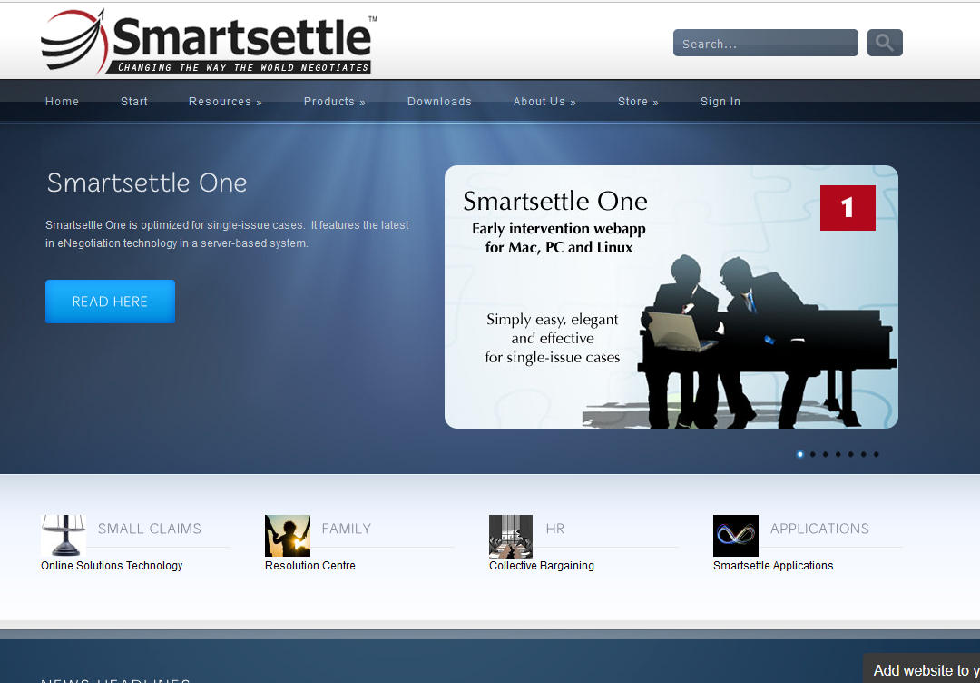

Slide 13
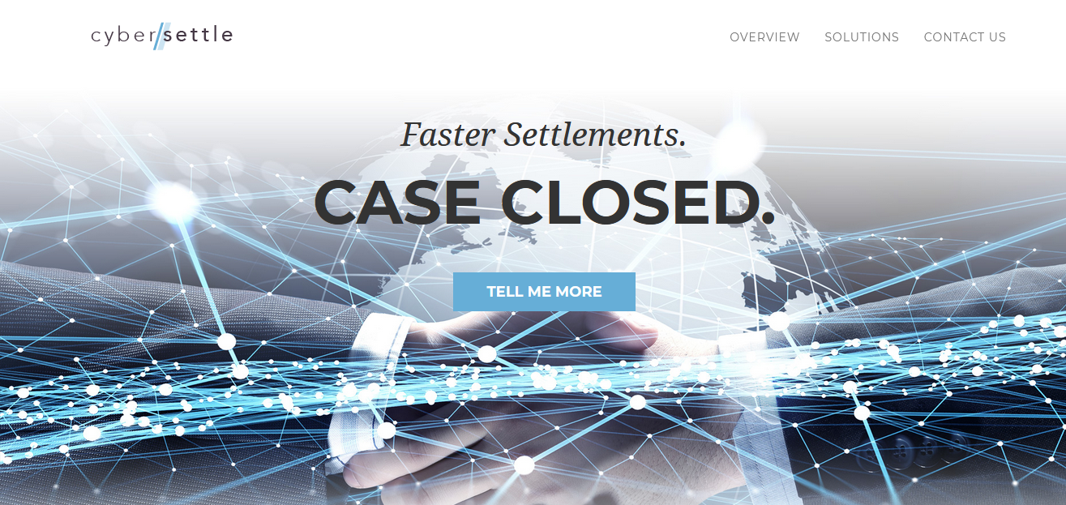

Slide 14
clickNsettle.com
Notes:
Good afternoon and once again thank you all for coming today. My name is Bob Mack, and I am Executive Vice President of Business Development for clickNsettle.com.
Yes that’s right, we have now arrived at the “marketing” part of today’s seminar. And since dinner and cocktails start as soon as I am finished, I promise to keep this brief.

Slide 15
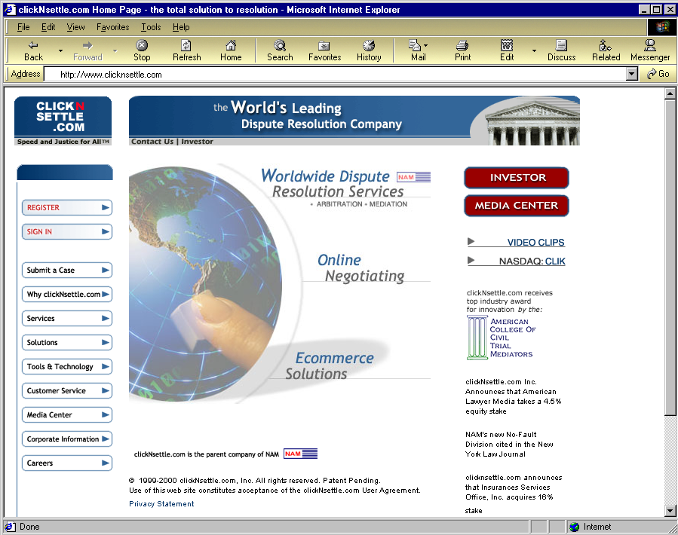
This is the clickNsettle.com Home Page

Slide 16
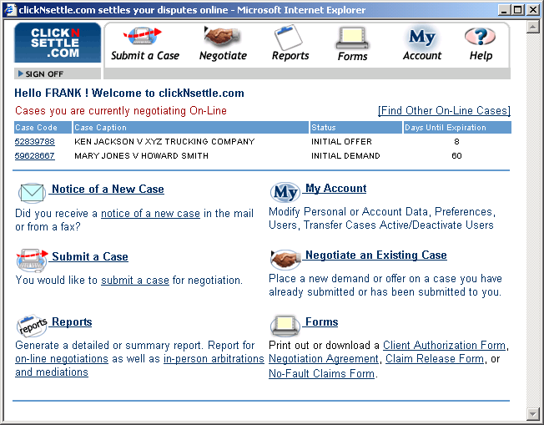
Select Submit a Case

Slide 17
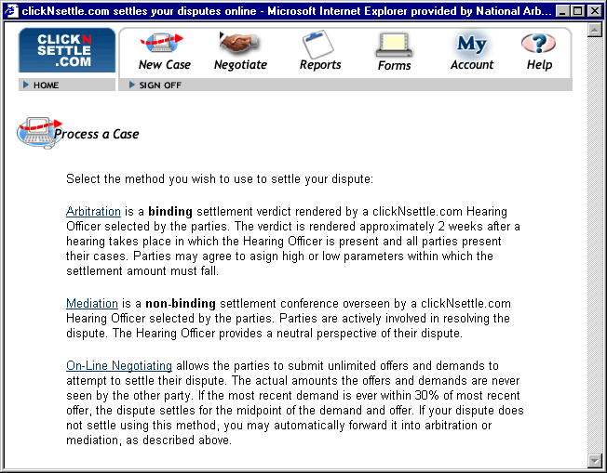
Select On-Line Negotiating

Slide 18
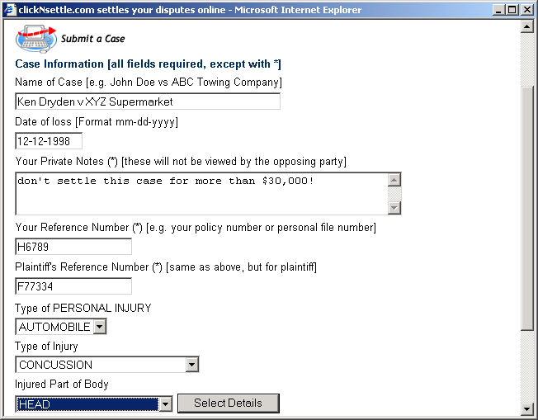
Fill out form

Slide 19
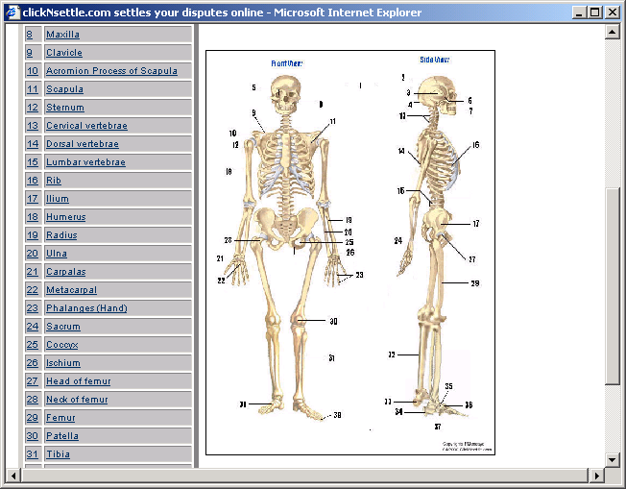
Select Injury Details

Slide 20
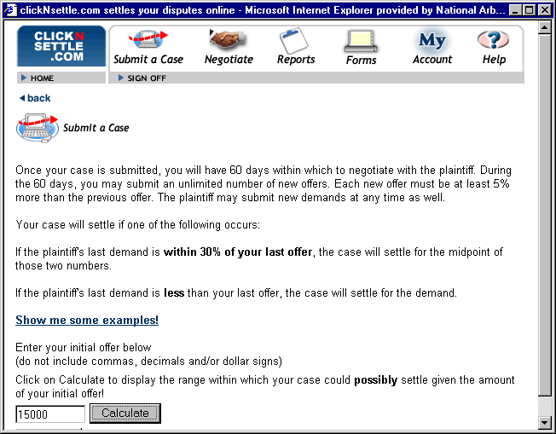
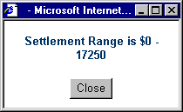
Enter initial offer

Slide 21
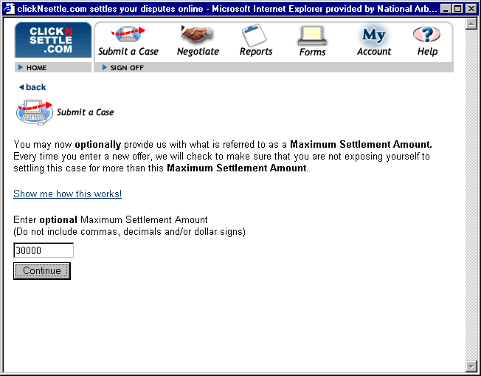
Enter optional maximum settlement amount.

Slide 22

Once the case is submitted, clickNsettle.com contacts the other party. The other party may then begin negotiating. Each party may submit an unlimited number of new offers or demand for up to 60 days.
Each new offer must increase a minimum of 5%. Each new demand must decrease by a minimum of 5%.
Either party may terminate negotiations at any time.
If the last demand is within 30% if the last offer, the case settles for the midpoint of the offer and demand.
If the last demand is less than the last offer, the case settles for the demand.

Slide 23
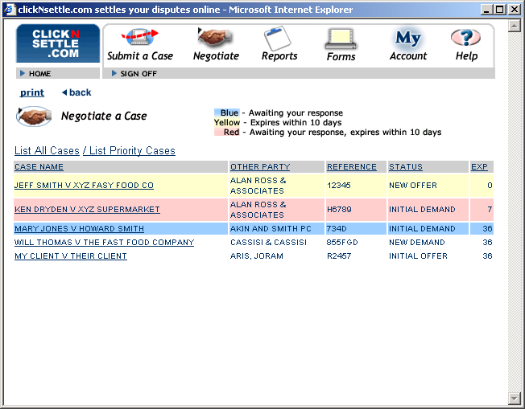
NEW DEMAND
Click on Negotiate to list active cases, color-coded to indicate priority level. Click on 2nd case.

Slide 24
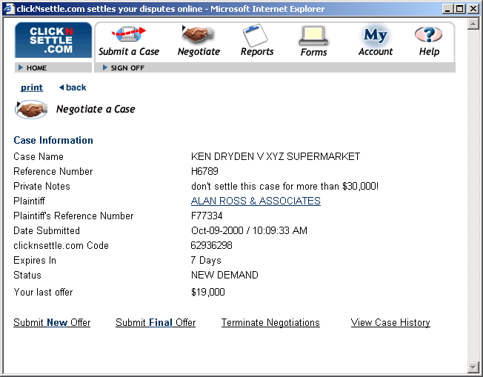
Clicking on case brings up negotiating screen.

Slide 25
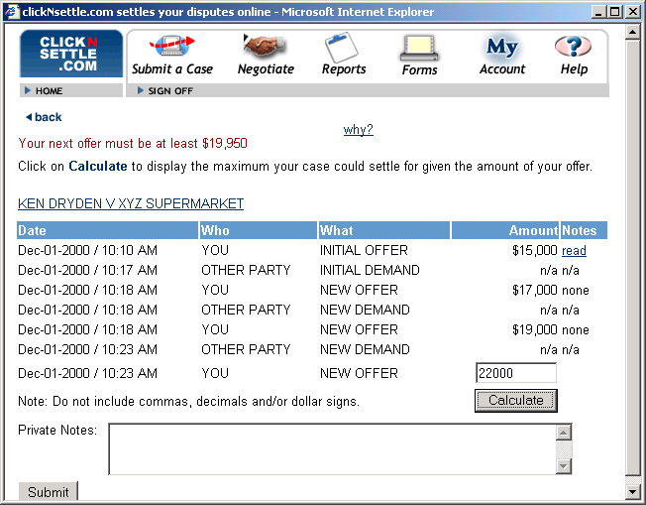
Typical Negotiating scenario, enter a new offer of $22,000

Slide 26
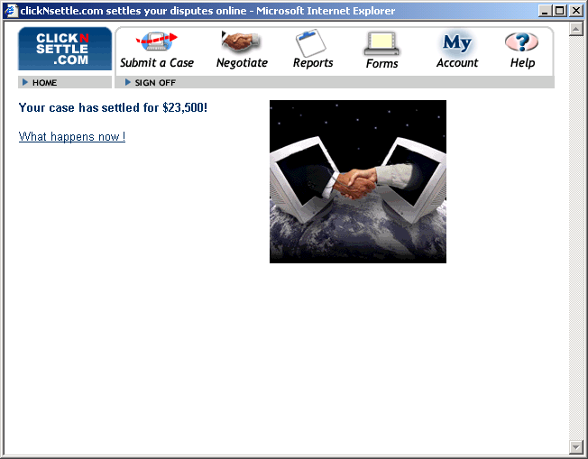

Last demand was $25,000, new offer of $22,000 settles case for $23,500!

